Slide 1



Slide 2
Revelation 18

Slide 3
Revelation 18 - Overview
Responses to Villains’ Judgment
1. Rev 18:1-14
God’s response
2. Rev 18:15-19
World’s merchant’s response
3. Rev 18:20-24
Heaven’s response
Chapter 16 (Armageddon) was not the end of the world!

Slide 4
Revelation 18:3-5
³ For all nations have drunk of the wine of the wrath of her fornication, and the kings of the earth have committed fornication with her, and the merchants of the earth are waxed rich through the abundance of her delicacies.
⁴ And I heard another voice from heaven, saying, Come out of her, my people, that ye be not partakers of her sins, and that ye receive not of her plagues.
⁵ For her sins have reached unto heaven, and God has remembered her iniquities.

Slide 5
Revelation 18:3-5
Kings of the Earth
Rev 6:15
Rev 16:14
Rev 17:1
Rev 17:18
Rev 18:3
Rev 18:4
Rev 18:9
Rev 19:9
.....
....
.....
....
.....
.....
.....
.....
Hid in mountains from God’s wrath
Prepare for battle against God
Committed “fornication” with harlot
Allow harlot to reign over them
Received wealth and power from harlot
Saints told to come out from among them
Do not partake in their sins, plagues
Mourn harlot’s judgment
Make war against the Lamb of God

Slide 6
Revelation 18:3 - Translations
³ For all nations have drunk of the wine of the wrath of her fornication, and the kings of the earth have committed fornication with her, and the merchants of the earth are waxed rich through the abundance ¹ of her delicacies ².
¹ δυνάμεως (dynameōs) - Ref #1411 ³
21x in N.T.
“Power”
² στρήνους (strēnous) - Ref #4764 ³
1x in N.T.
“Self-Indulgent Luxury”
³ biblehub.com

Slide 7
Revelation 18:7 - Translations
⁷ How much she hath glorified herself, and lived deliciously, so much torment and sorrow give her: for she saith in her heart, I sit a queen, and am no widow, and shall see no sorrow.
ἐστρηνίασεν (estrēniasen) - Ref #4763 ¹
2x in N.T.
“Lived in luxuriously”
¹ biblehub.com

Slide 8
Revelation 18:9 - Translations
⁹ And the kings of the earth, who have committed fornication and lived deliciously with her, shall bewail her, and lament for her, when they shall see the smoke of her burning,
στρηνιάσαντες (strēniasantes) - Ref #4763 ¹
2x in N.T.
“Having lived luxury”
¹ biblehub.com

Slide 9
Revelation 18:19 - Translations
¹⁹ And they cast dust on their heads, and cried, weeping and wailing, saying, Alas, alas, that great city, wherein were made rich all that had ships in the sea by reason of her costliness! for in one hour is she made desolate.
τιμιότητος (timiotētos) - Ref #5094 ¹
1x in N.T.
“Overwhelming wealth, riches, and worth”
¹ biblehub.com

Slide 10
Revelation 18:9-11
⁹ And the kings of the earth, who have committed fornication and lived deliciously with her, shall bewail her, and lament for her, when they shall see the smoke of her burning,
¹⁰ Standing afar off for the fear of her torment, saying, Alas, alas, that great city Babylon, that mighty city! for in one hour is thy judgment come.
¹¹ And the merchants of the earth shall weep and mourn over her; for no man buys their merchandise any more:
1 Timothy 6:10
¹⁰ For the love of money is the root of all kinds of evil: which while some coveted after, they have erred from the faith, and pierced themselves through with many sorrows.

Slide 11
Revelation 18: Merchandise
KJV
¹³ And cinnamon, and odors, and ointments, and frankincense, and wine, and oil, and fine flour, and wheat, and beasts, and sheep, and horses, and chariots, and slaves, and souls of men.
Greek ¹
¹³ and cinnamon and spice and incense and myrrh and frankincense and wine and olive oil and finest flour and wheat (grain) and domestic animals and sheep and of horses and of carriage (chariots) and of bodies and spirits of humans
Greek is more verbose - 32 items
Review merchandise using Greek list
¹ biblehub.com
Notes:
Merchandise impacted by judgment of the “Harlot”, the villain of Revelation.
¹² The merchandise of gold, and silver, and precious stones, and of pearls, and fine linen, and purple, and silk, and scarlet, and
all thyine wood, and all manner vessels of ivory, and all manner vessels of most precious wood, and of brass, and iron, and marble,
¹³ And cinnamon, and odours, and ointments, and frankincense, and wine, and oil, and fine flour, and wheat, and beasts, and sheep, and horses, and chariots, and slaves, and souls of men.
¹⁴ And the fruits that thy soul lusted after are departed from thee, and all things which were dainty and goodly are departed from thee, and thou shalt find them no more at all.

Slide 12
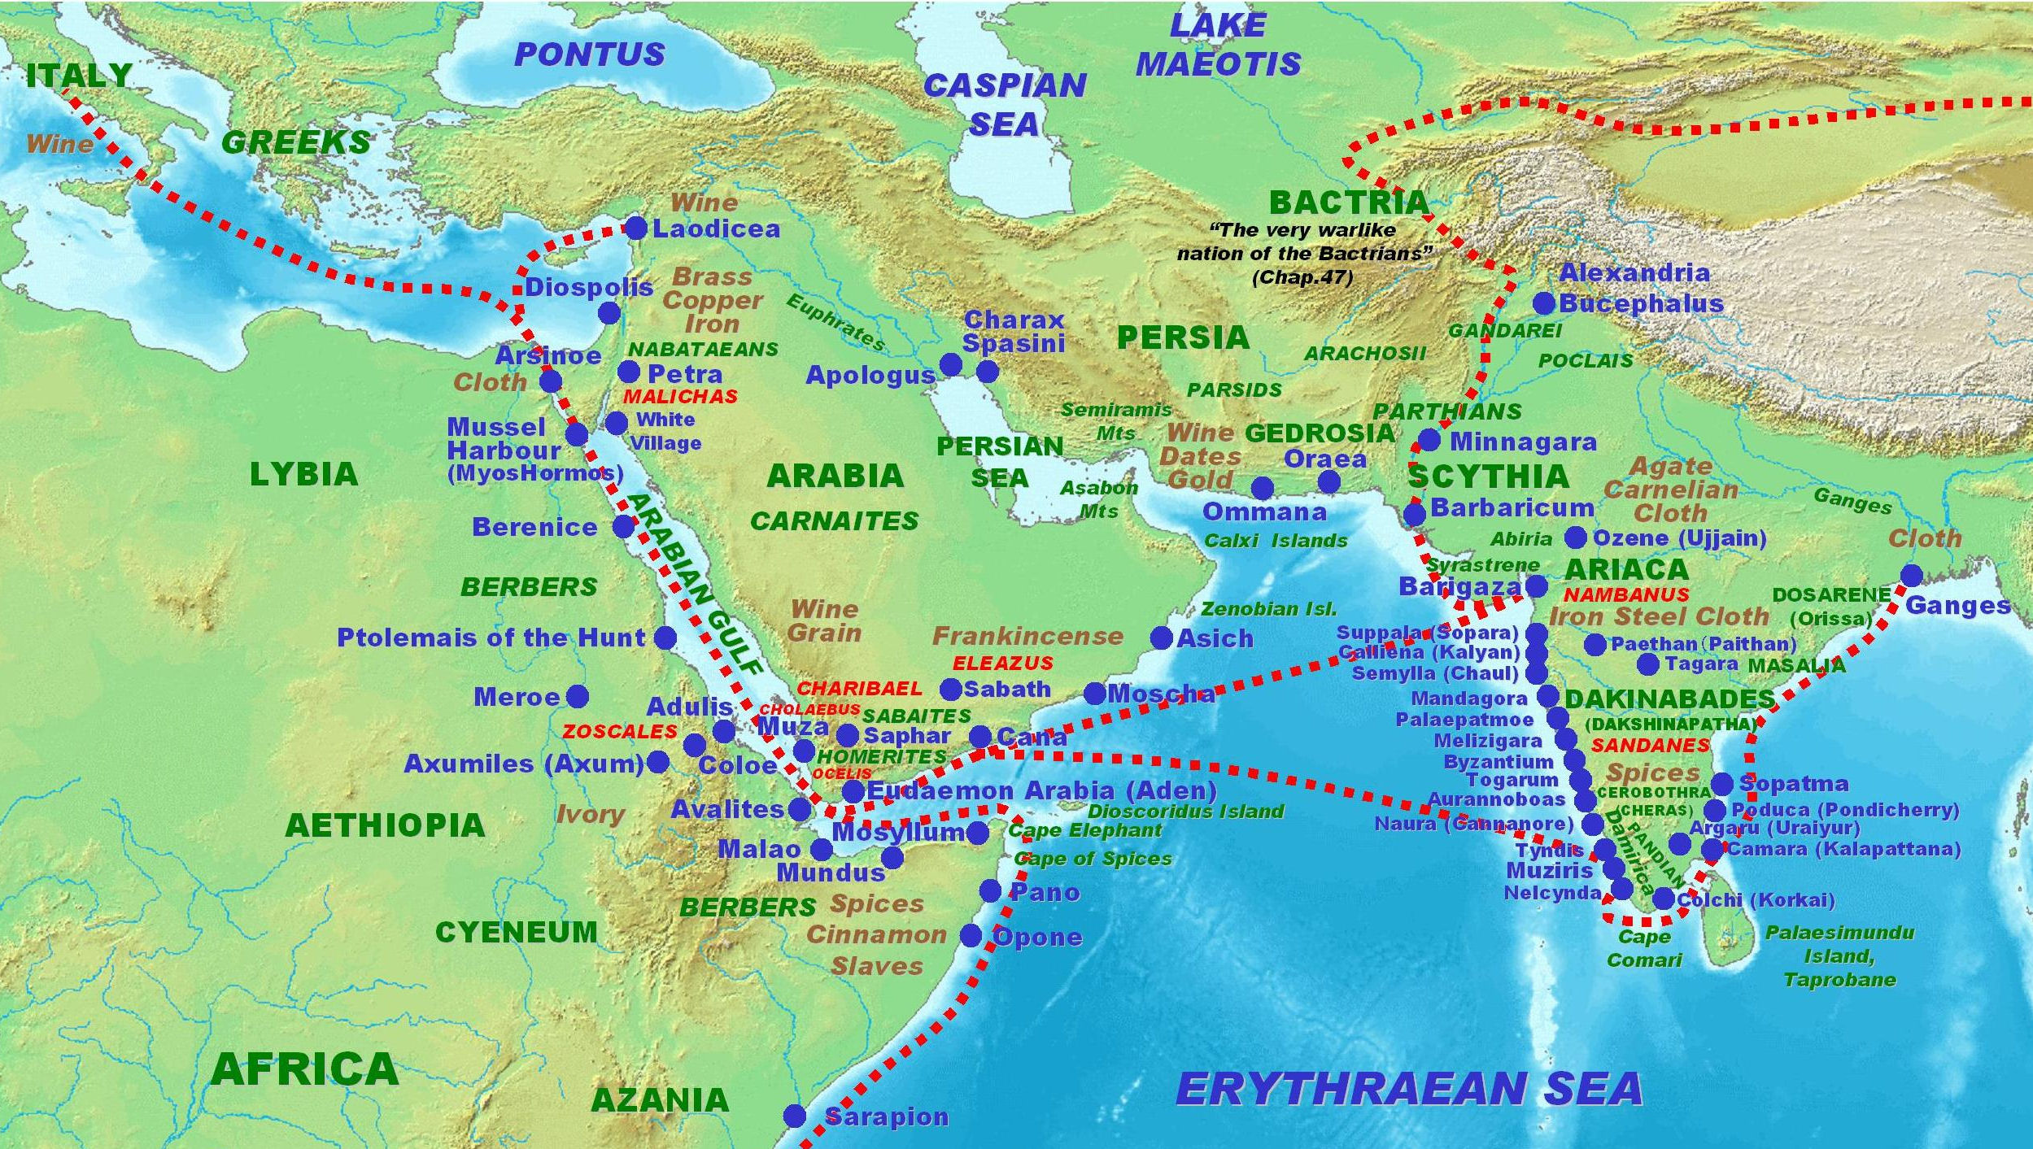
Revelation: Downloads
Notes:
KJV consolidates or generalizes some of Greek language that is listing merchandise.
Following charts are going to follow the biblehub.com Greek exactly.
Some merchandise is more specific than KJV translation.
Laodicea had a direct trade route of its own! Great wealth!

Slide 13

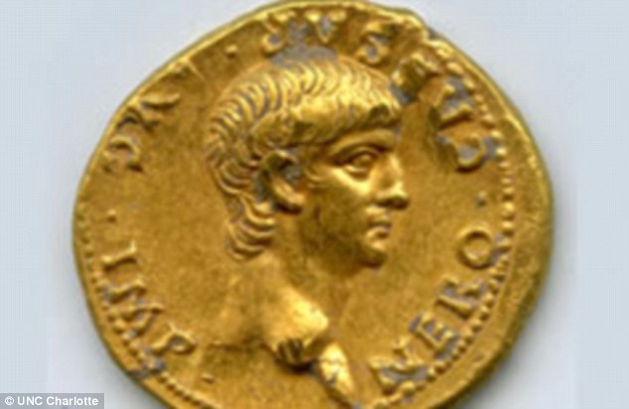
Revelation 18: Gold
Nero gold coin
found in Jerusalem
Gallo-Roman Lion Earrings
7 – 1 BC
Notes:
South Central Asia, N. Africa, W. Europe, N. Europe,

Slide 14
Revelation 18: Silver
Silver cup with Centaurs detail
Roman A.D. 1-100 AD;
Augustus
Caesar
Notes:
Northern Asia

Slide 15

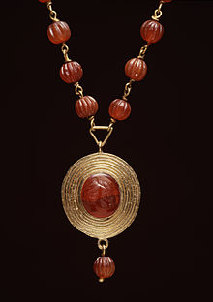
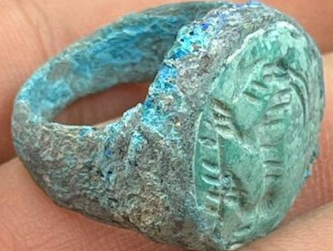

Revelation 18: Valuable Stones
Ancient Roman turquoise stone ring
Roman gold necklace and rings with carnelian stone
Notes:
India, Egypt, Persian Gulf
Agate, Stone, Carnelian, Turquoise, Garnet
garnet, emeralds, jasper, and lapis were imported from Egypt
onyx, amber, and moonstone imported from the Persian Gulf
AMETHYST, Beryl, CHALCEDONY, CHRYSOLITE, crystal, Emerald, jasper, Hyacinth (ligurus), Onyx, carnelian, CHRYSOPRASUS, sapphire, topaz,

Slide 16
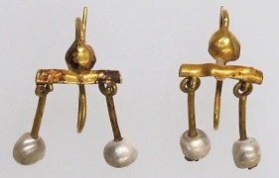
Revelation 18: Pearls
1st Century Gold and Pearl Earrings
Notes:
India, Red Sea, Persian Gulf

Slide 17
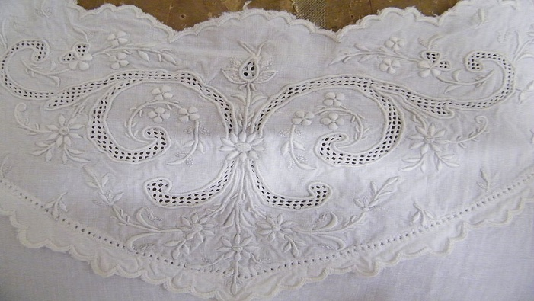
Revelation 18: Fine Linen; Cotton
Notes:
Egypt, India, northern Italy, Tarraco Spain
Cotton from India and N. Africa

Slide 18

Revelation 18: Purple (dye)
Notes:
Purple cloth and dye - India, Red Sea, Persian Gulf
The 1st century Roman purple dye, also known as Tyrian purple, was a highly prized and expensive dye made from the secretions of the murex snail. The process of extracting the dye was extremely labor-intensive and time-consuming, involving the collection of thousands of snails, which were then crushed and boiled to release the dye. The resulting dye was a deep, rich purple color that was highly valued for its vibrant hue and rarity.
In ancient Rome, purple was the color of royalty, and the dye was reserved for the use of the emperor and other high-ranking officials. The expense and difficulty of producing the dye made it a status symbol, and only the wealthy and powerful could afford to wear garments dyed with Tyrian purple.
The legend of the discovery of Tyrian purple dates back to the Phoenician god Melqart, who was said to have discovered the dye while walking along the seashore with his dog and the nymph Tyros. The story was first recorded by the Greek scholar Julius Pollux in the 2nd century AD.
The use of Tyrian purple was not limited to clothing, as it was also used to dye other materials such as silk, wool, and even hair. The dye was highly prized for its vibrant color and was often used to create elaborate and intricate designs on fabrics and other materials.
Despite its rarity and expense, Tyrian purple remained a popular color in ancient Rome, and its use continued well into the Middle Ages. Today, the term “Tyrian purple” is still used to describe a deep, rich purple color, and the dye remains a symbol of luxury and opulence.

Slide 19

Revelation 18: Silk
Notes:
China

Slide 20
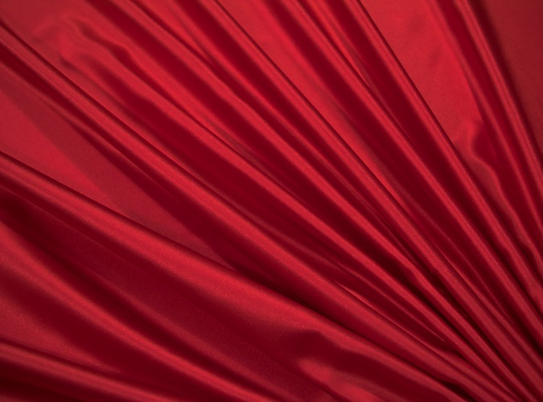
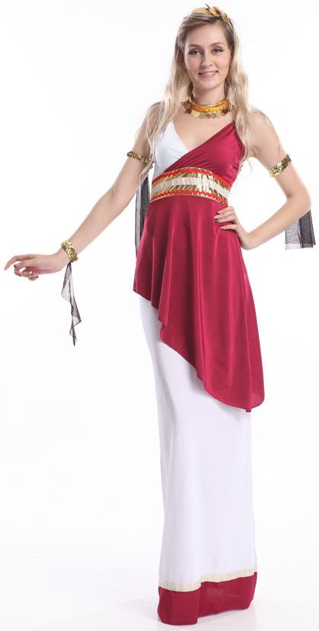
Revelation 18: Scarlet (dye)
Notes:
Scarlet dye – Persia
Scarlet was second in prestige only to purple.
The 1st century Roman red dye was derived from various sources, including kermes, a substance extracted from oak trees, and Porphyrophora hamelii, a type of scale insect that lived on the roots and stems of certain herbs. The Romans also used madder, a plant-based dye, to create a range of red shades. The use of these dyes was widespread in Roman culture, with red being a prominent color in fashion, art, and architecture.

Slide 21
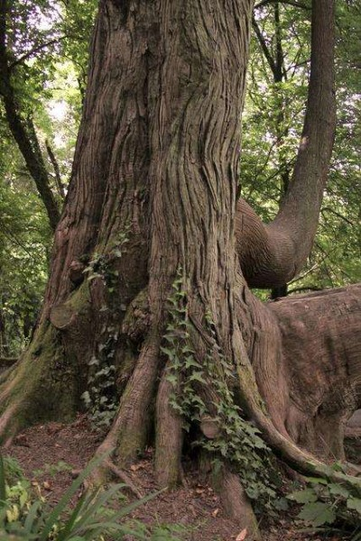
Revelation 18: Thyine (Citron) Wood
Notes:
Uncultivated hills on coast of Africa. Also called citron or citrus wood
Scented, fragrant wood
Very valuable for making furniture

Slide 22
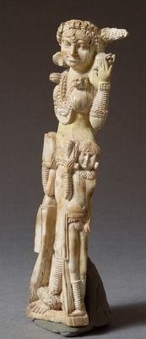
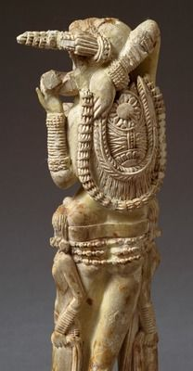
Revelation 18: Elephantine (Ivory)
Ivory statues
discovered in
Pompeii, Italy
Notes:
NE Africa, India

Slide 23
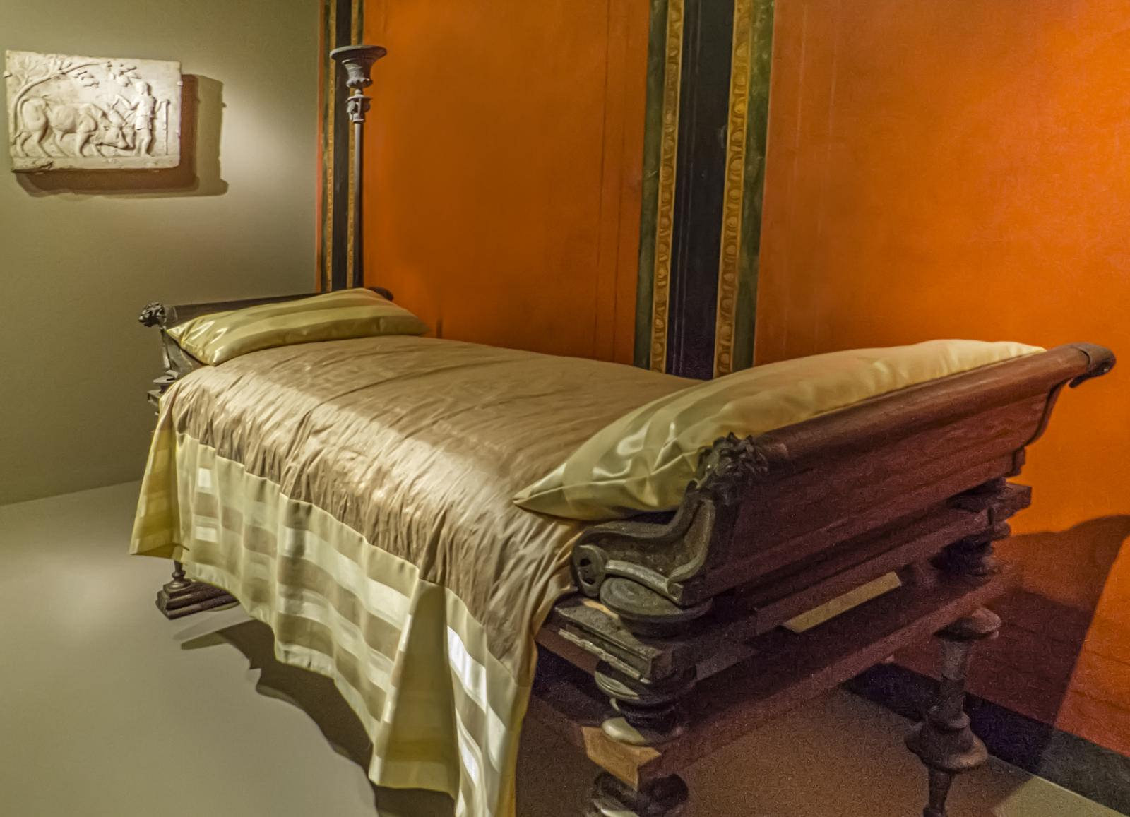
Revelation 18: Precious Wood
Roman 1st century dining couch; wood with bronze ornaments
Notes:
Oak from Mediterranean, Britain, Asia Minor, Sarmatia, Central Europe, and all over Roman Empire

Slide 24
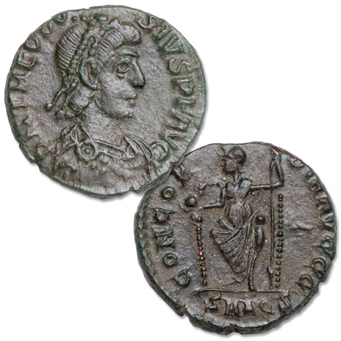
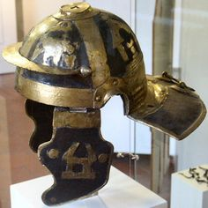
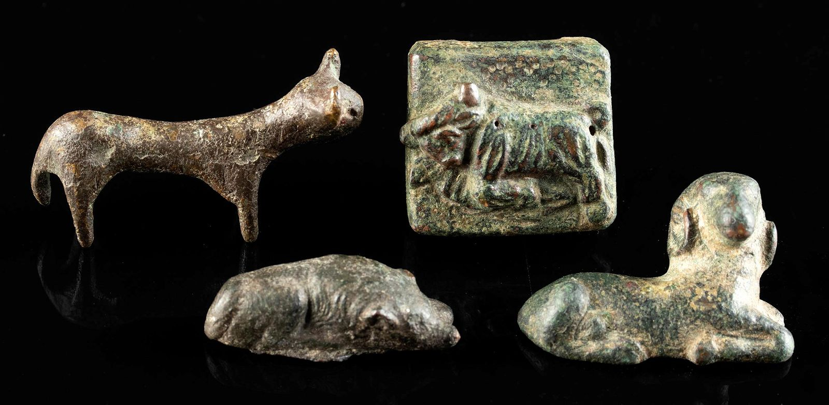
Revelation 18: Copper, Brass, Bronze
Theodosius I
379 AD
Bronze coins
Military helmet
Bronze, Brass, and Copper alloy statuettes
Notes:
Middle east, India
¹² The merchandise of gold, and silver, and precious stones, and of pearls, and fine linen, and purple, and silk, and scarlet, and all thyine wood, and all manner vessels of ivory, and all manner vessels of most precious wood, and of brass, and iron, and marble,
“chalkos” – copper, brass, and bronze; also used to mean “money”

Slide 25
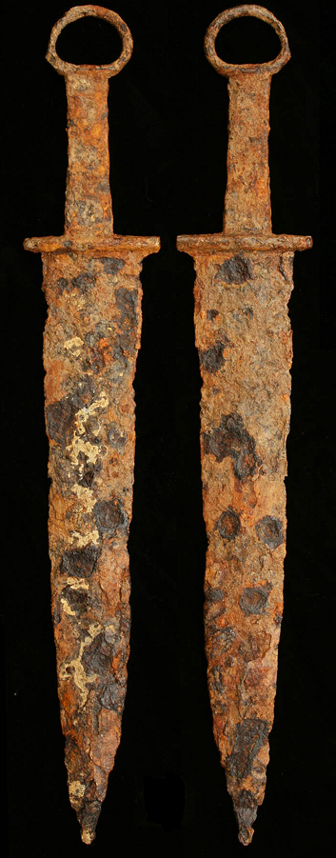
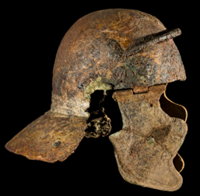
Revelation 18: Iron
Ancient Roman iron helmet and weapons
Notes:
Middle east, India, Central Europe, Northern Asia

Slide 26
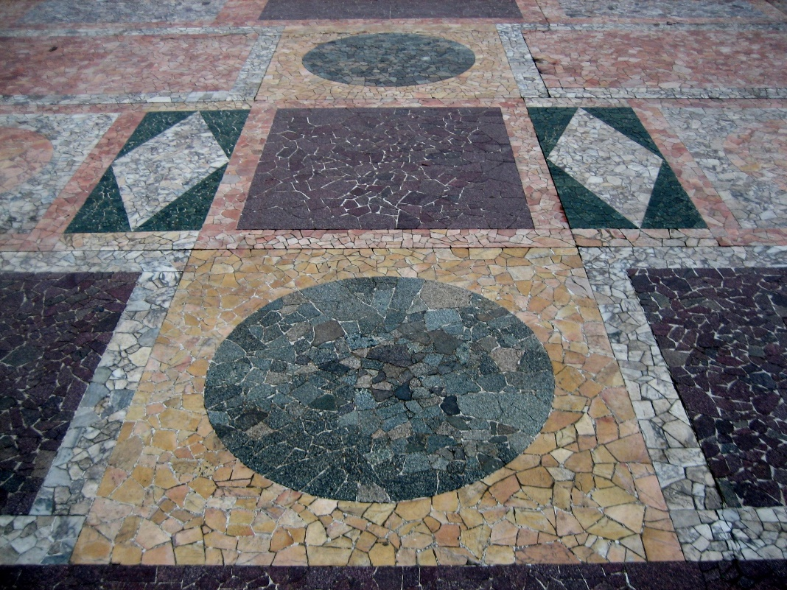
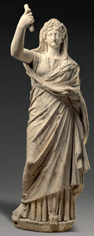
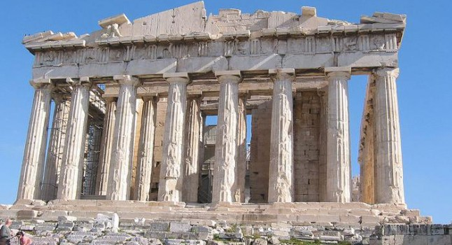
Revelation 18: Marble
Livia Drusilla
Wife of
Augustus
Caesar
Ancient Roman Marble flooring, pillars and statues
Notes:
NE Africa, Greece, Eastern Mediterranean

Slide 27
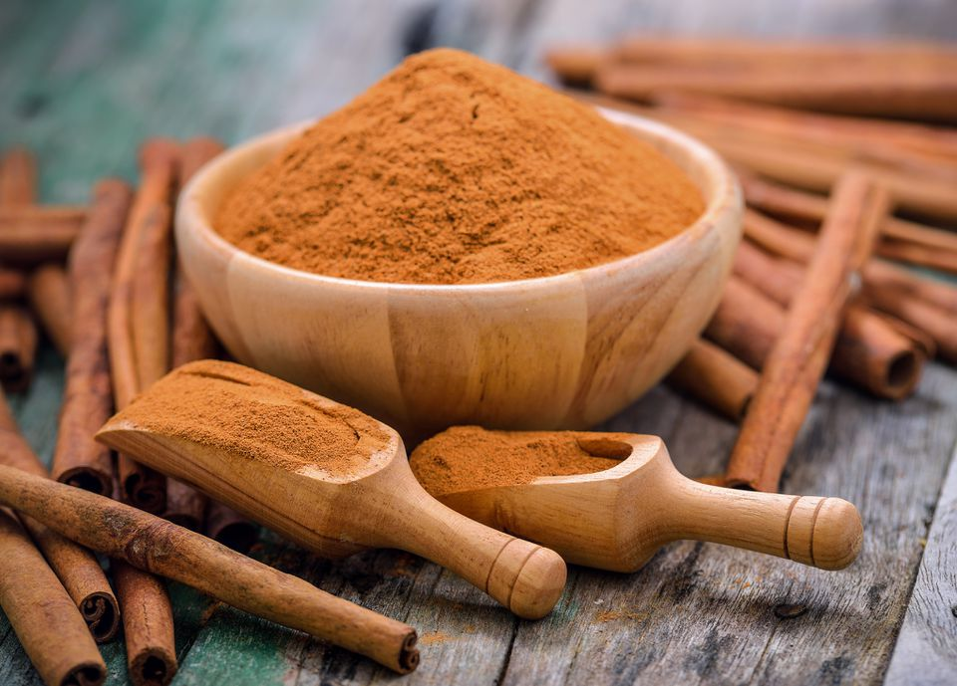
Revelation 18: Cinnamon
Notes:
Central Eastern Africa, India, from Arabian traders
According to Pliny, a Roman pound (327 grams (11.5 oz)) of cassia, cinnamon, or serichatum cost up to 300 denarii, the wage of ten months' labour. The Emperor Nero is said to have burned a year's worth of the city's supply at the funeral for his wife Poppaea Sabina in AD 65.

Slide 28
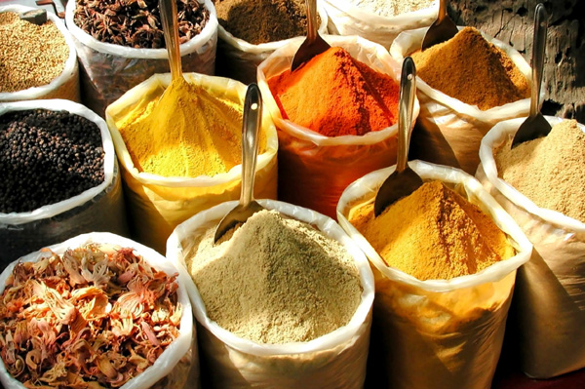
Revelation 18: Spices, Incense
Notes:
India, China, Indonesia (roses, lavender, quinces, pomegranates, grapes, basil, rosemary, and cinnamon)
¹³ And cinnamon, and odours, and ointments, and frankincense, and wine, and oil, and fine flour, and wheat, and beasts, and sheep, and horses, and chariots, and slaves, and souls of men.
https://www.fragrancescience.com/origins-and-history-of-incense/
Between 7th century BC and 2nd century AD existed something called “Incense trade route” or the “Incense Road”. It was a network of land and sea trading routes that connected Mediterranean with Levant and Egypt through Northeastern Africa and Arabia to India and its purpose was to mainly carry Arabian frankincense and myrrh (hence the name). It carried other types of goods from the east but these two items were predominant. This trade route lasted until the fall of Roman Empire.
Common to burn Terebinth & Cedar as incense (fragrant wood)

Slide 29
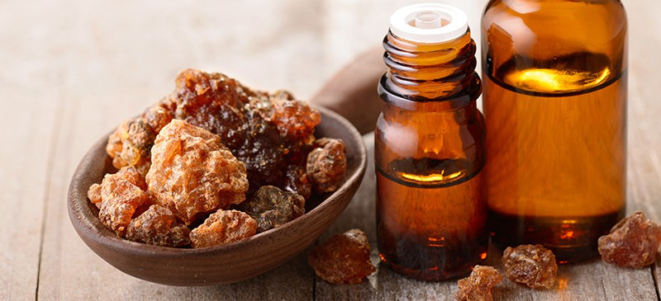
Revelation 18: Myrrh
Sap-like substance (resin) from bark of certain trees; oil, perfumes, ointments
Notes:
India, China, Indonesia (roses, lavender, quinces, pomegranates, grapes, basil, rosemary, and cinnamon)
¹³ And cinnamon, and odours, and ointments, and frankincense, and wine, and oil, and fine flour, and wheat, and beasts, and sheep, and horses, and chariots, and slaves, and souls of men.
https://www.fragrancescience.com/origins-and-history-of-incense/
Between 7th century BC and 2nd century AD existed something called “Incense trade route” or the “Incense Road”. It was a network of land and sea trading routes that connected Mediterranean with Levant and Egypt through Northeastern Africa and Arabia to India and its purpose was to mainly carry Arabian frankincense and myrrh (hence the name). It carried other types of goods from the east but these two items were predominant. This trade route lasted until the fall of Roman Empire.
Common to burn Terebinth (turpentine tree) & Cedar trees as incense (fragrant wood)
Myrrh is a gum-resin extracted from a number of small, thorny tree species of the genus Commiphor

Slide 30
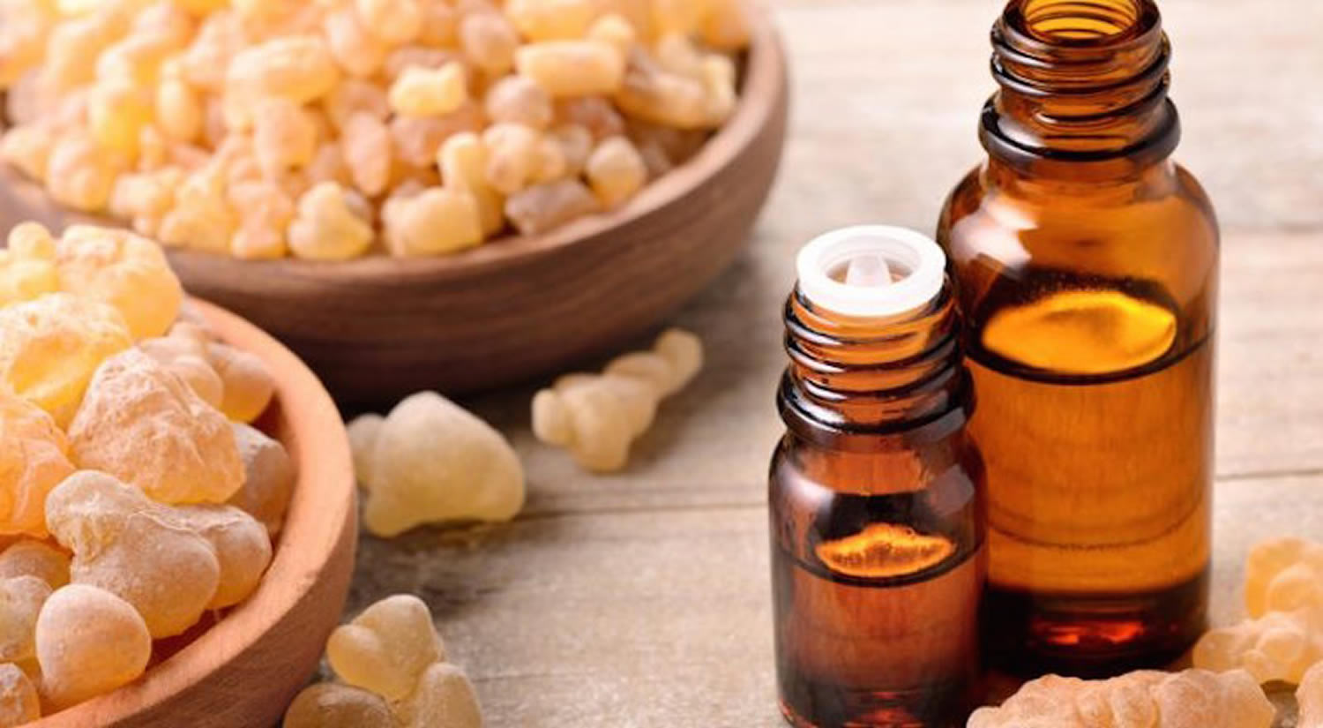
Revelation 18: Frankincense
Boswelia Sacra tree in Southern Saudi Arabia
Notes:
Saudi Arabia, Ethiopia, and Somalia
Frankincense is also a resin extracted as dry sap from Boswellia trees

Slide 31
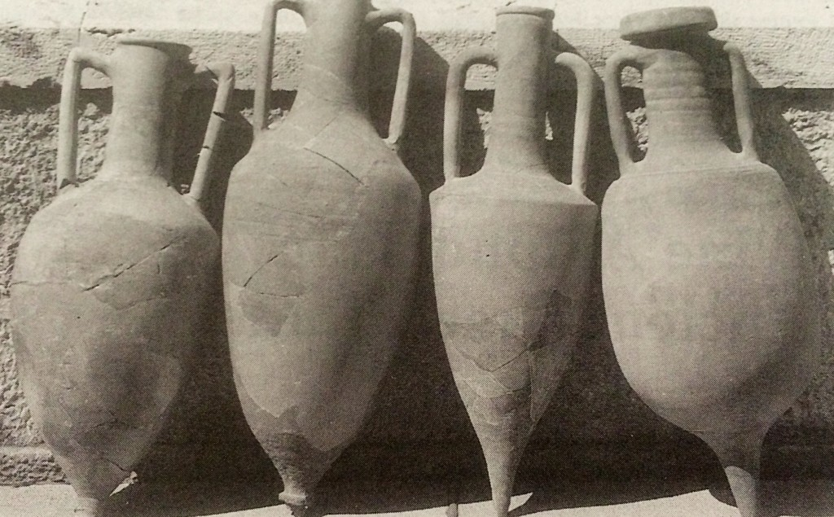
Revelation 18: Wine
Notes:
Vineyards of Italy and Greece, France, Germany, Portugal, and Spain
Possibly some from South Central Asia, Asia Minor, SE Arabia
The ancient city of Pompeii was one of the most crucial wine centers of the Roman world
All wine storages were destroyed in eruption of Mt. Vesuvius

Slide 32
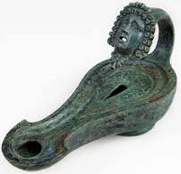
Revelation 18: Olive Oil
1st century Roman bronze oil lap with Goddess head
Notes:
Spain, olive trees throughout the Roman Empire especially in the Mediterranean area.
In addition to being an integral part of the diet, olive oil was used to make perfume, treat maladies, conduct religious rituals and provide lighting inside houses and temples.

Slide 33
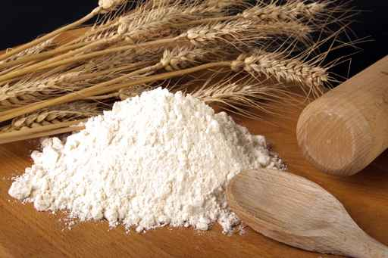
Revelation 18: Finest Flour
Notes:
Egypt, northern Africa, and Sicily

Slide 34
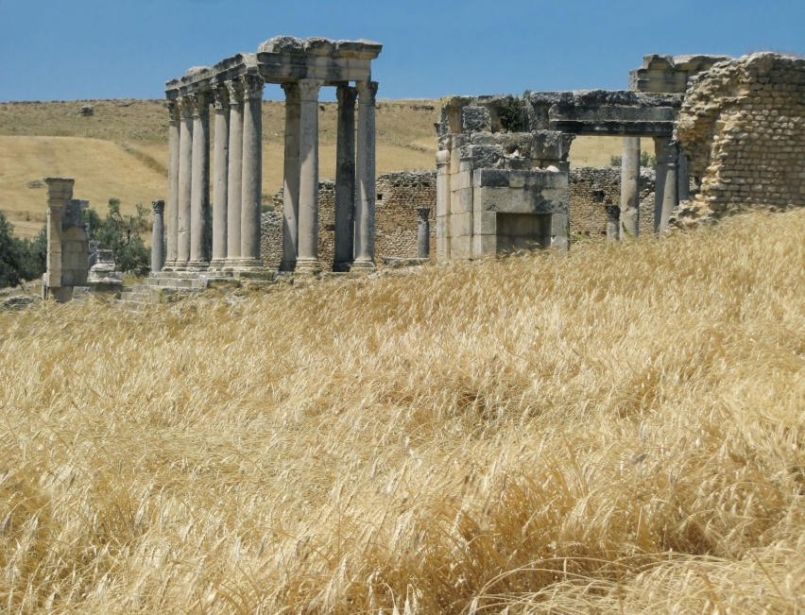
Revelation 18: Grain Wheat
Notes:
Egypt, northern Africa, and Sicily

Slide 35
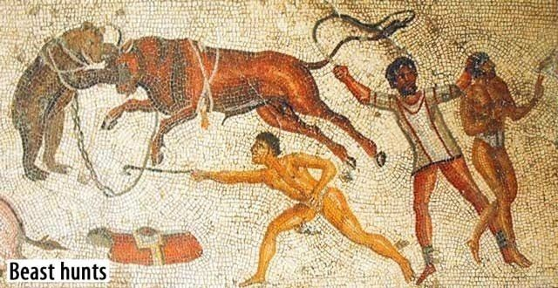
Revelation 18: Domesticated Animals
Cattle, domesticated animals, beasts of burden
Notes:
¹³ And cinnamon, and odours, and ointments, and frankincense, and wine, and oil, and fine flour, and wheat, and beasts, and sheep, and horses, and chariots, and slaves, and souls of men.
N. France, N. Africa, throughout Asia and Europe, Mesopotamia
Probably cattle
But, got exotic animals from Africa

Slide 36
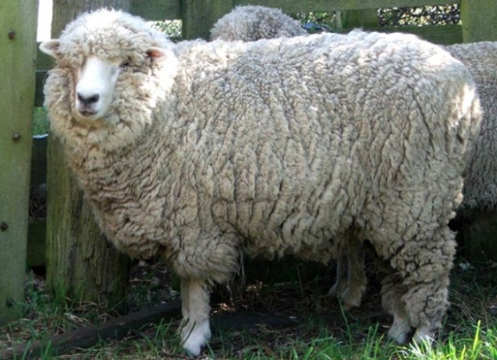
Revelation 18: Sheep
Notes:
Middle East

Slide 37
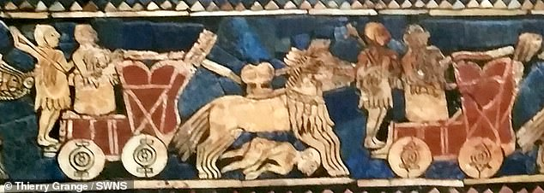
Revelation 18: Horses, Carriages (Chariots)
Sumerians – the people of southern Mesopotamia – had already been using horse-drawn four-wheeled war wagons on the battlefield for centuries, as evidenced by the famous 'Standard of Ur', a 4,500-year-old Sumerian mosaic.
Notes:
¹³ And cinnamon, and odours, and ointments, and frankincense, and wine, and oil, and fine flour, and wheat, and beasts, and sheep, and horses, and chariots, and slaves, and souls of men.
Horses – Greece
4 wheeled carriages as well as chariot - Europe with Mesopotamian design

Slide 38
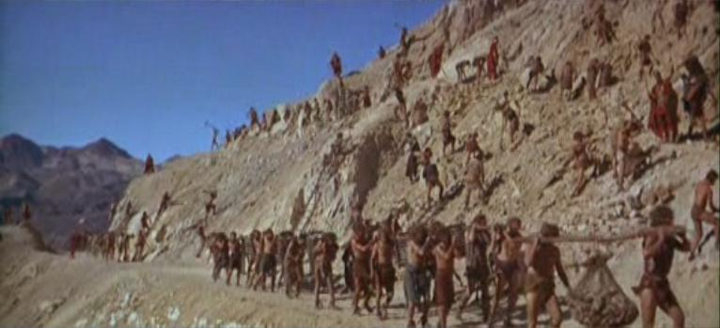
Revelation 18: Bodies and Breath of Humans
KJV: “slaves and souls of men” GR: “bodies and breath of humans”
Notes:
¹³ And cinnamon, and odours, and ointments, and frankincense, and wine, and oil, and fine flour, and wheat, and beasts, and sheep, and horses, and chariots, and slaves, and souls of men.
Europe, Mediterranean, N. Africa, Syria, Germany, Balkans, Greece, conquered lands
Roman 1st century slavery not based on race
Rev 9:20-21
“Theft” was one sin the villain was accused of

Slide 39
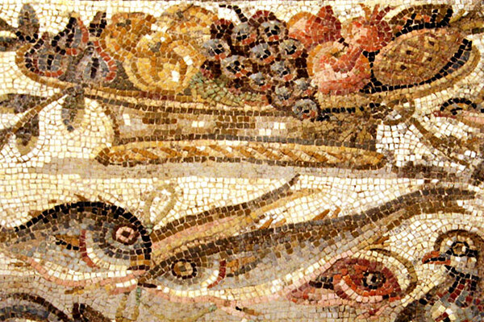
Revelation 18: Ripe Fruits
A 1st century B.C. Roman mosaic depicting a fruit basket
Notes:
¹⁴ And the fruits that thy soul lusted after are departed from thee, and all things which were dainty and goodly are departed from thee, and thou shalt find them no more at all.
GR: “the Autumn fruit of the desire of the soul”
Many Roman colonies provided Rome its fruits and vegetables
Pompeii – Archeology indicates fish and fruit were the major part of Roman diet for common people

Slide 40
Revelation 18: Merchandise Impacted
Gold
Silver
Valuable stones
Pearls
Fine Linen; cotton
Purple
Silk
Scarlet
Citron (fragrant) wood
Ivory
Precious wood
Copper
Brass
Bronze Iron
Marble
Cinnamon
Spices
Incense
Myrrh
Frankincense
Wine
Olive oil
Finest flour
Grain
Wheat
Domesticated animals
Horses
Carriages
Chariots
Bodies, breath of humans
Autumn fruit
Notes:
32 products
Trade impacted by the judgment of the “Harlot”, the villain of Revelation.
Could 1st century Israel have this kind of impact on the world?
Any place other than Rome?
Clearly, Rome is the villain of Revelation.

Slide 41
Revelation: Why Impacted
Revelation 16:6
⁶ For they have shed the blood of saints and prophets, and Thou has given them blood to drink; for they are worthy.
Revelation 18:24
²⁴ And in her was found the blood of prophets, and of saints, and of all that were slain upon the earth.
Revelation 18:20
²⁰ Rejoice over her, thou heaven, and ye holy apostles and prophets; for God hath avenged you on her.
Notes:
We do not have to guess why judgment is made
CoC routinely and habitually ignore “Forbidden Zone” – Rev 6 – 20
That is where all the answer are located

Slide 42
Revelation 18: Who Was Impacted
Villain
Kings of earth
Merchants
Shipmasters
All who had ships
Sailors
All who trade by sea
Notes:
Seems everyone was in on the action.
The answer to this question is the villain (The “Harlot”) of Revelation.

